Slide 1

Training Workshop
Session 1: Introduction

Slide 2
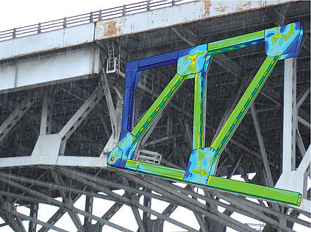
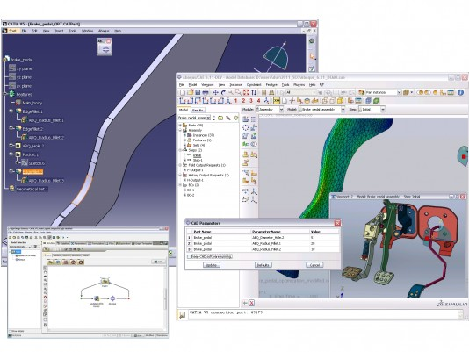
User-friendly FEA software solving complex mechanical problems:
  vehicle loads
  dynamic vibration
  multibody systems
  impact/crash
  nonlinear static analysis
  thermal coupling
  acoustic–structural coupling
ABAQUS mastery saves time and money by optimizing designs before testing them.

Slide 3
ABAQUS Ecosystem
CAD
Systems
Associative
interfaces
ABAQUS/CAE
Elysium direct
translators
Visualization
ABAQUS/Visualizer
Modeling
Job control/monitoring
Analysis
ABAQUS/Standard
ABAQUS/Explicit
ABAQUS/Aqua
ABAQUS/AMS
ABAQUS/Design
Third-party
preprocessors
Translators
CAD can be performed with third-party software.
We will utilize the ABAQUS/CAE modeling environment.
Translators
Several solvers are available, based on the problem to be solved.
Third-party
postprocessors

Slide 4
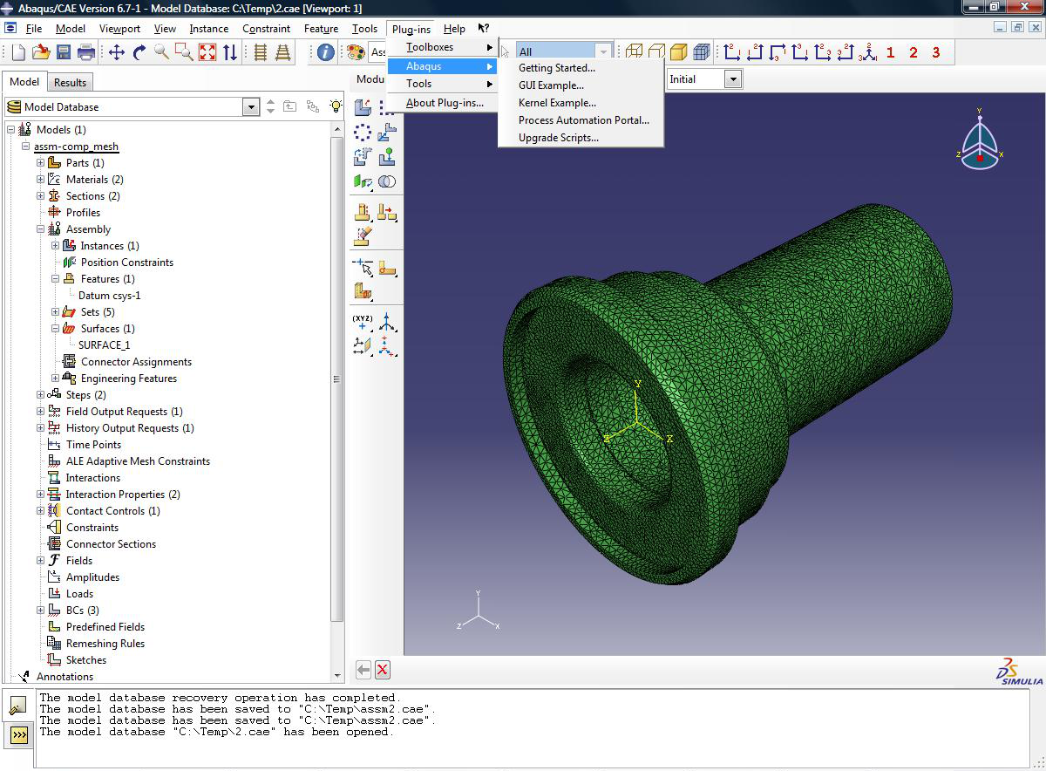
ABAQUS/CAE
Menu bar
Toolbar
Context bar
Model
tree
Toolbox
area
Canvas/
viewport
Prompt
area
Message area/
command-line
interface

Slide 5
Ready to do a simulation with ABAQUS?

Slide 6
Beam Exercise
y axis 2
200 Pa
x axis 1
Steel beam with continuous loading of F = 200 Pa
  E = 2 × 10¹¹ Pa Young’s modulus
  ν = 0.26 Poisson's ratio
  L × W × H = (200 cm) × (20 cm) × (20 cm) Dimensions

Slide 7
ABAQUS Workflow
Sketch 2D geometry and create part representing frame.
Define material properties & section properties of frame.
Assemble model.
Configure analysis procedure & output requests.
Apply loads and boundary conditions to frame.
Mesh frame.
Create job and submit it for analysis.
Postprocessing—view results of analysis.
Tutorial
Workflow

Slide 8
ABAQUS Tutorial
Dynamic &
Contact FEA
Postprocessing
ABAQUS
Material &
Section Properties
Job Processing
(Solver)
Loading &
Analysis Steps
Meshing

Slide 9
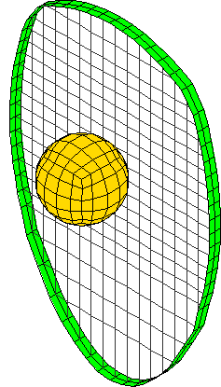
ABAQUS Postprocessing
Creating and submitting jobs from input files.
Viewing with basic options
Animating results
Plotting model energy histories
Evaluating acceleration histories

Slide 10
Beam Exercise
Steel beam with end load of 20,000 Pa at x_{L} = 200 cm
E = 2 × 10¹¹ Pa Young’s modulus
ν = 0.26 Poisson's ratio
ρ = 7.8 × 10³ Density
L = 200 cm Length
∅ 20 cm
y axis 2
20,000 Pa
x axis 1

